Slide 1
Interacting with MDIA
An Overview of MDIA’s currently available tech-certification regime
(session 10:45AM – 11:15AM)

Slide 2
Overall Guiding Principle
Direct contact through info@mdia.gov.mt
Contact the authority for a meeting to understand your service and/or technology.
Only then you can be guided directly to the best path and available options for you.
We want to understand your goals, target clients and needs

Slide 3
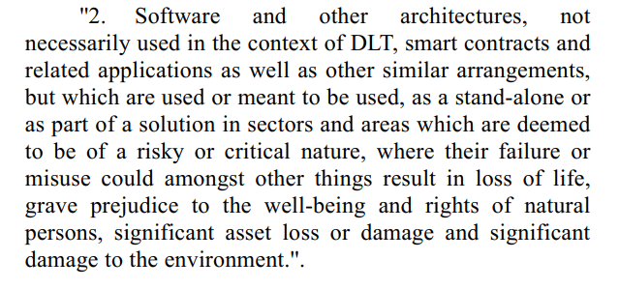
Are you recognised by the Authority as a possible ITA?
ITA = Innovative Technology Arrangement
A legal term in (Chap 592) ITAS ACT of the LAWS OF MALTA that initially focused heavily on structures related to DLT.
This regulatory/technological term that was widened through LN 389/2020 as follows:

Slide 4
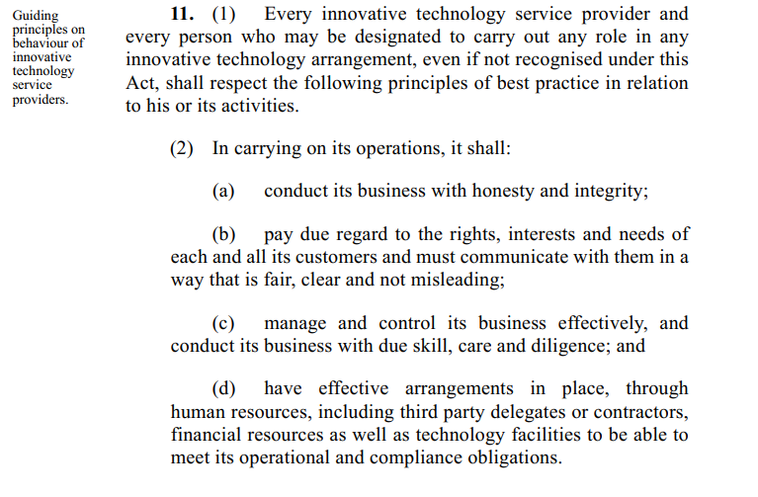
If you want to register as a possible ITA Service Provider.
Technical Administrator Registration
Systems Auditor Registration

Slide 5
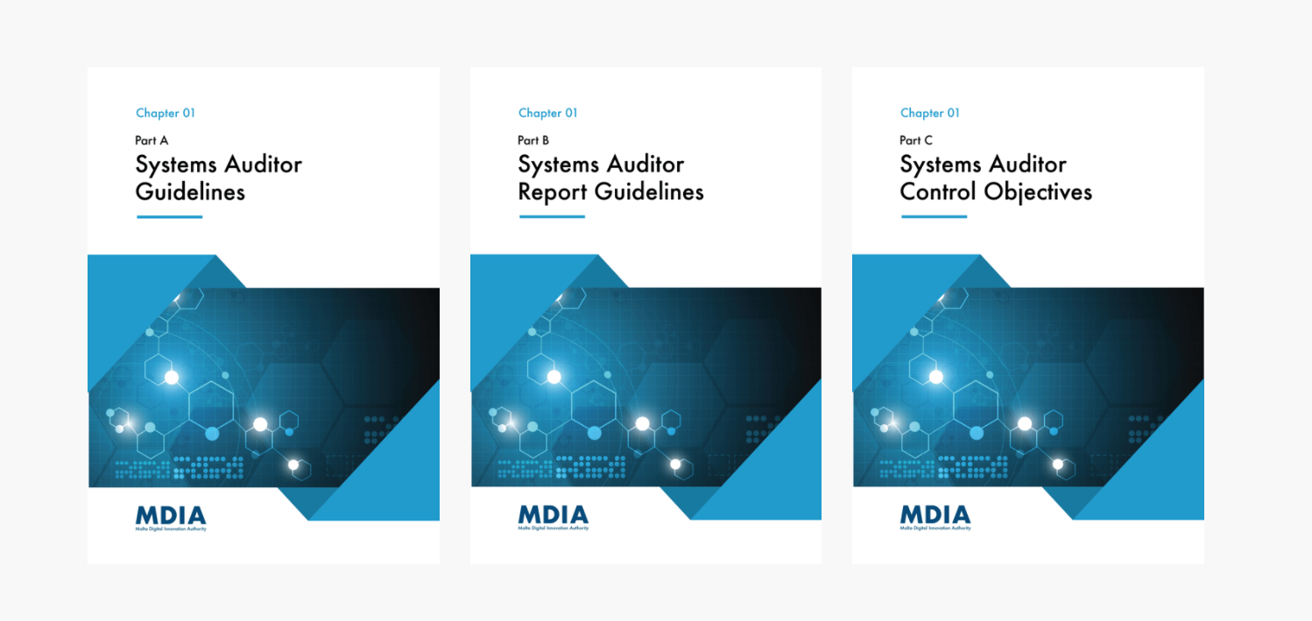
MDIA Guidelines (Systems Auditors)
MDIA Guidelines contain key information as in relation to:
Expected Control Objectives
Expected Methodology of Audit
Frequency of the Audits (TYPE I and TYPE II)
Publicly available at: https://mdia.gov.mt/sa-guidelines/
Focus on Part A, B, C bundled on purpose as a starting guide.

Slide 6
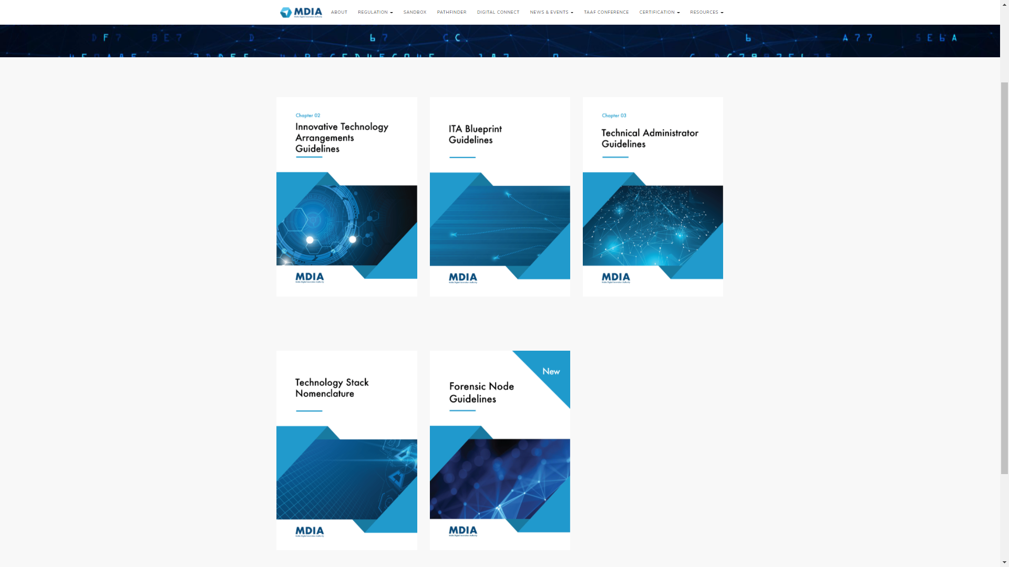
MDIA Guidelines (Innovative Technology Arrangement - ITA)
MDIA ITA-Guidelines contain key information as in relation to:
Application Process (explaining STAGE 1 (letter of intent) and subsequently STAGE 2).
STAGE 1
The Authority will need to ascertain that the ITA meets the generic and specific requirements contemplated within the ITAS Act. Apart from looking at the technological aspect, prior to issuing a Certificate, the Authority will also need to ascertain that the Applicant of the ITA, as well as, key functionaries are of good repute and standing. In this respect, the Applicant is required to complete and submit an ITA Application Form to the Authority.

Slide 7
MDIA Guidelines (Innovative Technology Arrangement - ITA)
STAGE 2
Following receipt of the Letter of Intent, the Applicant shall engage with the Systems Auditor to carry out the Systems Audit as indicated by the Authority. Upon conclusion of the Systems Audit and receipt of the Systems Auditor Report, the Applicant shall forward the Systems Audit Report to the Authority to initiate the second stage of the certification application process. This submission shall be accompanied by the second instalment of the Processing Fee. .
Upon a positive conclusion of this stage, the Authority will issue the Certification of the ITA and update the Register of Recognitions accordingly. In line with the Third Schedule of the ITAS Act, the ITA Certification shall be valid for a term of two years.

Slide 8
MDIA Guidelines (Innovative Technology Arrangement - ITA)
Further Key Guidelines explain further ITA Requirements.
Key of which are:
THE ITA BLUEPRINT – A most important key document. The basis of the technology arrangement.
THE EXISTANCE OF, CAPACITY, AVAILABILITY OF THE TECHNICAL ADMINISTRATOR
TECHNOLOGY STACK NOMENCLATURE [this guideline focuses on a DLT-Type nomenclature as an example as to what would be expected to be extracted out of a BLUEPRINT in terms of technology]
The existence, understanding, availability and requirements of the FORENSIC NODE.
Found at https://mdia.gov.mt/ita-guidelines/

Slide 9
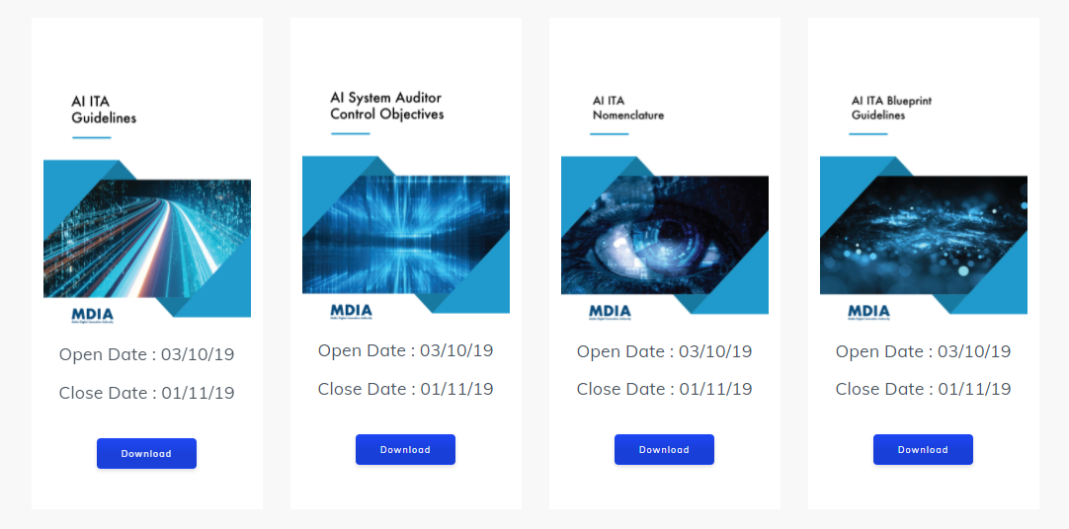
Later Developments (brought about by LN 389/2020 – widening of MDIA’s remit in technology)
Innovative Technology Arrangements that are AI based.
AI Based ITA’s have specific guidelines found at https://mdia.gov.mt/consultation/
These were created before the Artificial Intelligence Act (Draft) by EU Commission and yet, are still relevant to AIA as a lot is very similar to the proposed AIA (Draft). Can serve as a preparatory tool of existing solutions.

Slide 10
Remember: The Overall Guiding Principle
Always do get in touch with MDIA for a good technology-driven discussion.
We acknowledge that every technology is setup differently and legislation can be clumsy at tackling it (more on that on the aims of the MDIA-TAAF framework by CTO)
Direct contact through info@mdia.gov.mt
Contact the authority for a meeting to understand your service and/or technology.
Only then you can be guided directly to the best path and available options for you.

Slide 11
THANK YOU Email: Trevor.Sammut@mdia.gov.mt

